Slide 1
ACTIVITY Diagram
18CSC202J
Object Oriented Design and Programming

Slide 2
Activity Diagram
Activity diagram is UML behavior diagram which emphasis on the sequence and conditions of the flow
It shows a sequence of actions or flow of control in a system.
It is like to a flowchart or a flow diagram.
It is frequently used in business process modeling. They can also describe the steps in a use case diagram.
The modeled Activities are either sequential or concurrent.

Slide 3
Benefits
It illustrates the logic of an algorithm.
It describes the functions performed in use cases.
Illustrate a business process or workflow between users and the system.
It Simplifies and improves any process by descriptive complex use cases.
Model software architecture elements, such as method, function, and operation.

Slide 4
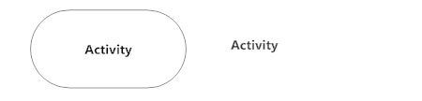
Symbols and Notations
Activity
Is used to illustrate a set of actions.
It shows the non-interruptible action of objects.

Slide 5

Symbols and Notations
Action Flow
It is also called edges and paths
It shows switching from one action state to another. It is represented as an arrowed line.

Slide 6
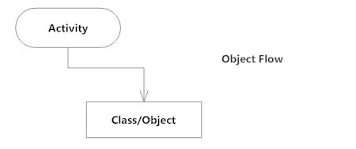
Symbols and Notations
Object Flow
Object flow denotes the making and modification of objects by activities.
An object flow arrow from an action to an object means that the action creates or influences the object.
An object flow arrow from an object to an action indicates that the action state uses the object.

Slide 7

Symbols and Notations
Decisions and Branching
A diamond represents a decision with alternate paths.
When an activity requires a decision prior to moving on to the next activity, add a diamond between the two activities.
The outgoing alternates should be labeled with a condition or guard expression. You can also label one of the paths "else."

Slide 8
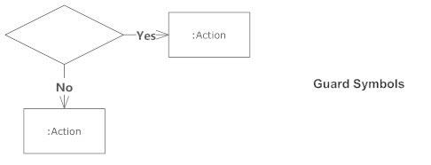
Symbols and Notations
Guards
In UML, guards are a statement written next to a decision diamond that must be true before moving next to the next activity.
These are not essential, but are useful when a specific answer, such as "Yes, three labels are printed," is needed before moving forward.

Slide 9
Symbols and Notations
Synchronization
A fork node is used to split a single incoming flow into multiple concurrent flows. It is represented as a straight, slightly thicker line in an activity diagram.
A join node joins multiple concurrent flows back into a single outgoing flow.
A fork and join mode used together are often referred to as synchronization.

Slide 10
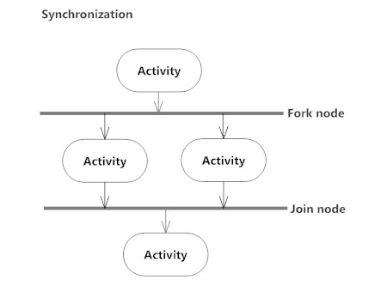
Symbols and Notations
Synchronization

Slide 11
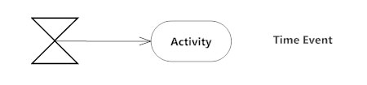
Symbols and Notations
Time Event
This refers to an event that stops the flow for a time; an hourglass depicts it.

Slide 12
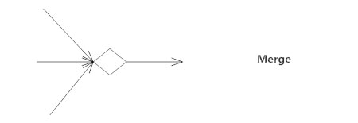

Symbols and Notations
Merge Event
A merge event brings together multiple flows that are not concurrent.
Final State or End Point
An arrow pointing to a filled circle nested inside another circle represents the final action state.

Slide 13
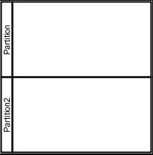
Symbols and Notations
Swimlane and Partition
A way to group activities performed by the same actor on an activity diagram or to group activities in a single thread

Slide 14
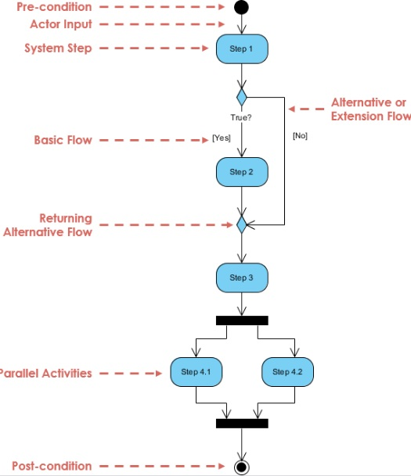
Activity Diagram

Slide 15
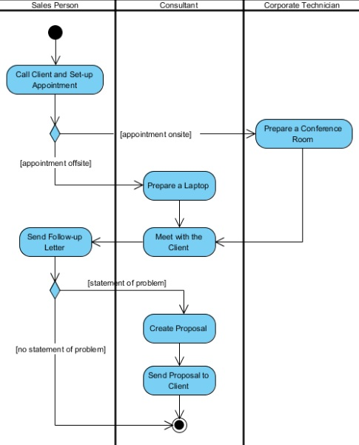
Activity Diagram with Swimlane

Slide 16
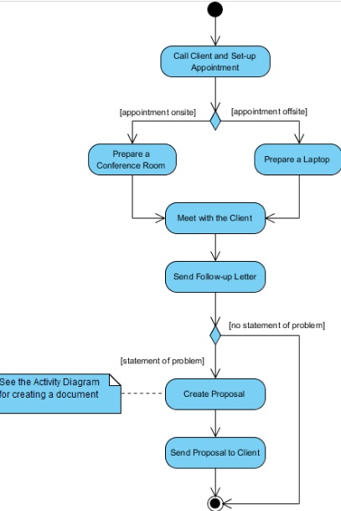
Activity Diagram without Swimlane

